Slide 1
Music Recommendation System
Presented by Mousumi Sen
Junior Data Scientist @ Becode

Slide 2
Overview
Project Pipeline
About Dataset
Data Exploration and Visualization
Building Recommendation System using Cosine Similarity
Demo
Future Improvement

Slide 3
Project Pipeline
Clean the dataset to ensure to have numerical values
Explore & create data visualization with song features
Download Dataset from Spotify Website
Create vector for each song based on the numerical features
Create an App using Flask & html files & Deploy it in Locally
Select the top 10 songs as a recommendation
Rank the songs based on the vector
Using Cosine Similarity
create the similar vectors for songs

Slide 4
About dataset
The dataset contains audio statistics of the top 2000 tracks on Spotify from 1998-2020. The data contains about 18 columns each describing the track and it's qualities. Columns are: artist, song, duration_ms, explicit, year, popularity, danceability, energy, key, loudness, mode, speechiness, acousticness, instrumentalness, liveness, valence, tempo, genre.

Slide 5
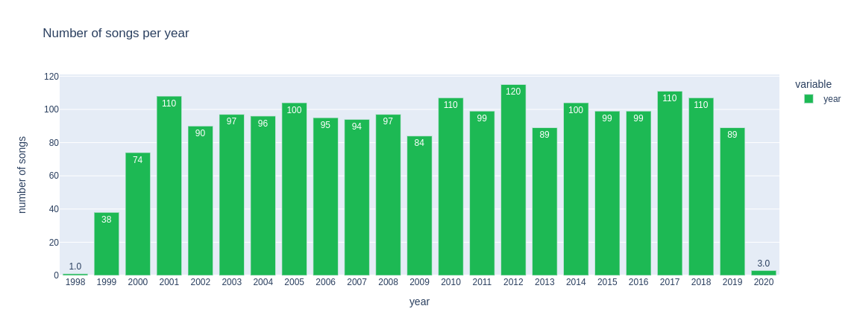
Data Exploration and Visualization

Slide 6
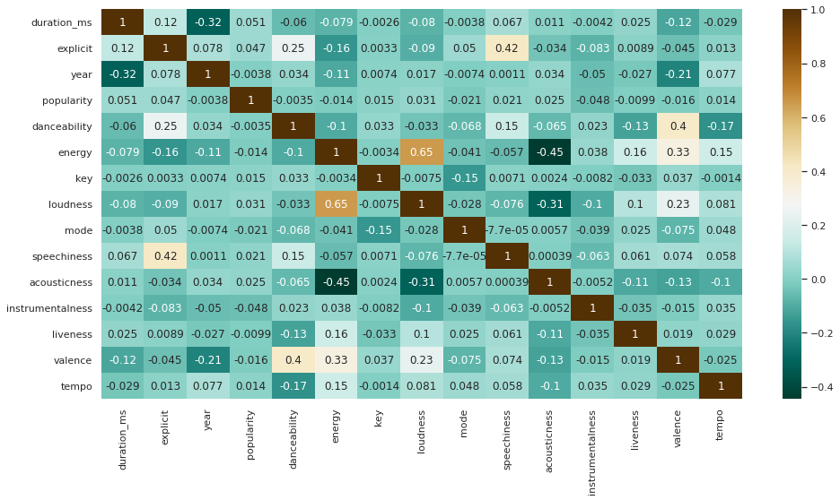
Correlation graph

Slide 7
Observation of Correlation graph
As per above correlation graph we can see :
1. Popularity is highly correlated with new released songs in recent year
2. Energy is also effect on song's popularity
.
3. Acousticness seems to be uncorrelated with popularity and also is highly negatively correlated
with energy, loudness, and year.
4. Loudness and energy are highly correlated.
5. Valence and danceability are highly correlated.

Slide 8
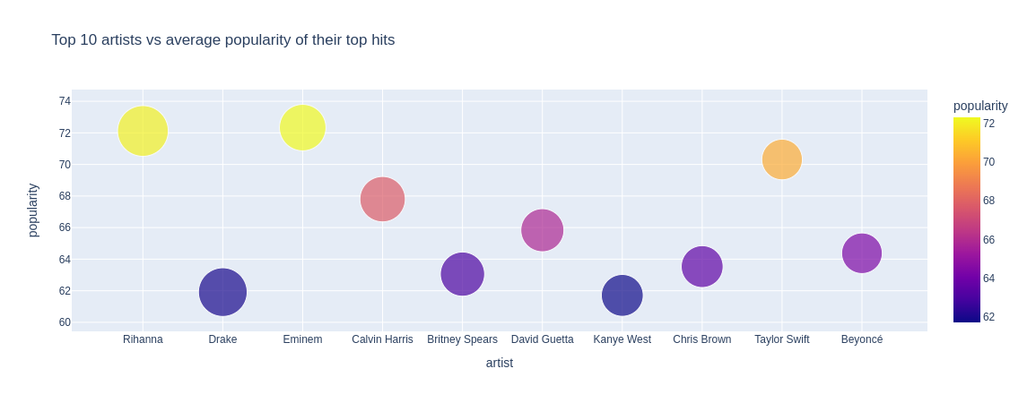

Slide 9
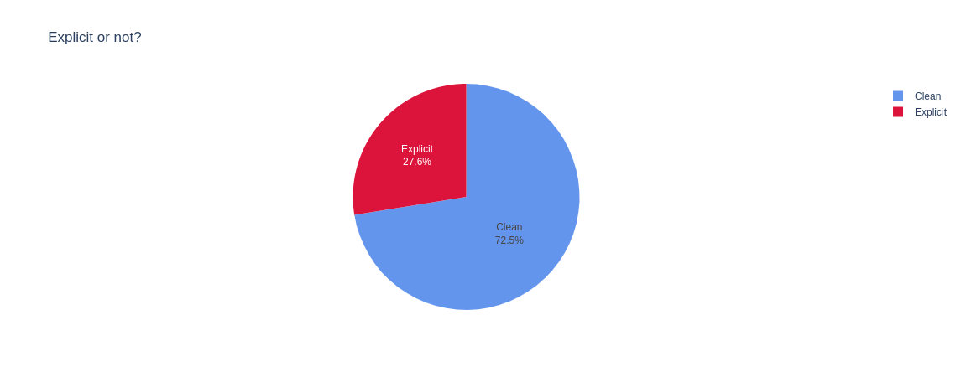

Slide 10
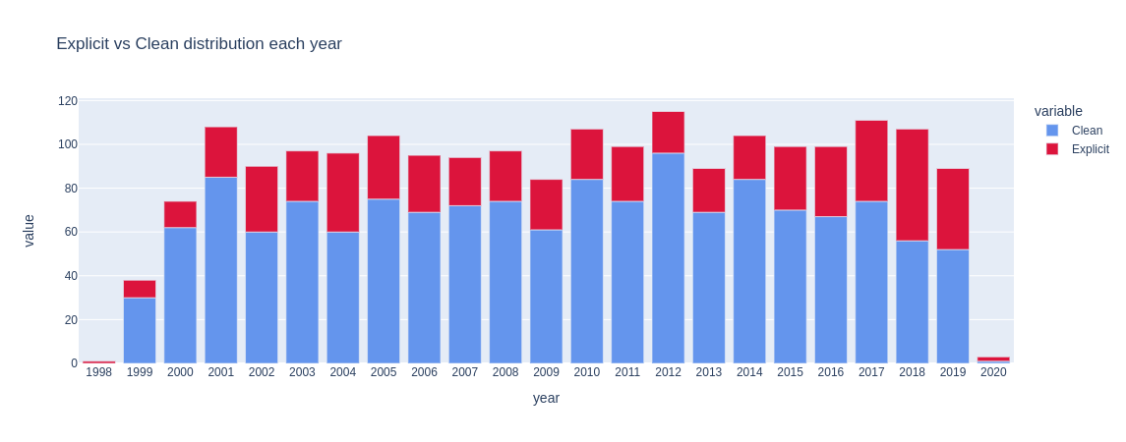

Slide 11
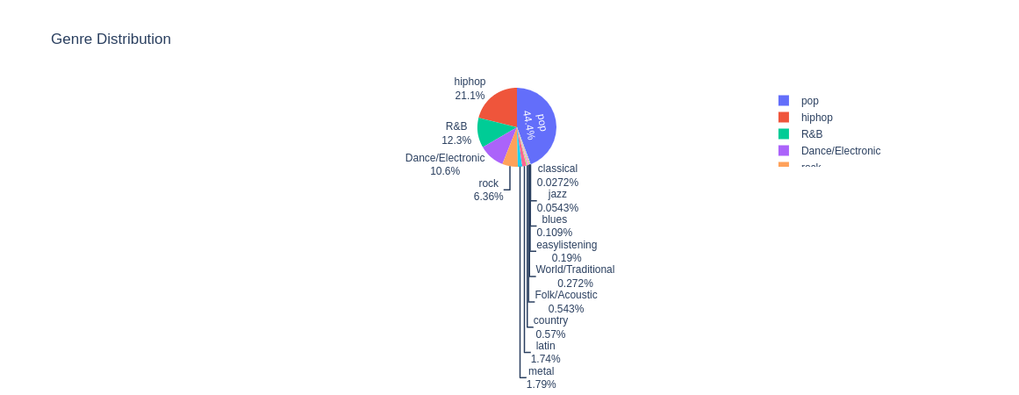

Slide 12
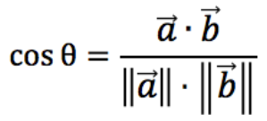
Building Recommender System using Cosine Similarity
Cosine Similarity:
Cosine similarity measures the cosine angle between two feature vectors. Its value implies that how two records are related to each other.
Based on Cosine Similarity, Music recommendation System recommend user top 10 most similar songs.

Slide 13
Demo

Slide 14
Future Improvement
Search based on important features
Including media player to play songs
To create a playlist
Enhancing the UI to include menus like Top 10 songs, Popular Artists etc
Increase the database using scraping
Showing suggestion when the user search songs by lyrics

Slide 15
Thank you
Question?
www.linkedin.com/in/mousumi-sen
https://github.com/MousumiAria

